Slide 1
Addressing Equity, Diversity, and Inclusion in VC and National Awards
Access and Equity

Slide 2
Equity, Diversity and Inclusion
Rather than use the term equality, which is about sameness, we maintain an equity approach that:
ensures people are treated fairly but differently;
focuses on the needs of individual and groups;
identifies differences and tries to reduce the gaps between groups; and
involves rational and logical decision-making.
Diversity is our demographics and representation and refers to the mix of our people at ECU – that is, all the differences between all our people however they choose to identify.
Inclusion means getting our mix of people to work together to improve performance and well-being.
Put simply: Diversity is what you have – inclusion is what you do. It is only through inclusion that organisations can make the most of their diversity.
- Diversity Council Australia
(ECU Equity, Diversity and Inclusion Blueprint 2020-2021)

Slide 3
From equality to equity and social justice
Inequality: Unequal access to opportunities.
Equality: Evenly distributed tools and assistance.
Equity: Custom tools that identify and address inequality.
Justice: Fixing the system to offer equal access to both tools and opportunities.
(Trede, Lewis & Percy, 2022)
Notes:
Successive government policy places responsibility for improving student equity in higher education institutions with the institutions.

Slide 4
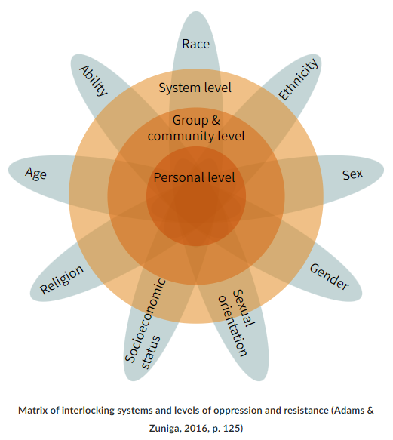
Modernising how we think about equity
Formally designated groups
Low socioeconomic status (Low SES)
Students with disability
Aboriginal and Torres Strait Islander
Women, especially in areas of study where they have been under-represented
Students from regional areas
Students from remote areas
Students from a non-English speaking background (NESB)
Other identified groups
First-in-family
Students from refugee backgrounds
Veterans
LGBTIQA+
Incarcerated
Carers
Parents
Out-of-home care
“Intersectionality is a lens through which you can see where power comes [from] and collides, where it interlocks and intersects. It’s not simply that there’s a race problem here, a gender problem here, and a class or LBGTQ problem there. Many times that framework erases what happens to people who are subject to all of these things.”
(Crenshaw, 1989; Crenshaw, 2017).
Notes:
Understand the socio-political and economic factors that have led to disadvantage today.
Know the difference between treating people equally and treating people equitably.
Queerphobia, ableism, racism and sexism operate within academia. The question is not, "do these oppressions exist?", but "how do they operate in leadership and strategic thinking?".
Nuanced explanations of how and why inequalities persist can be developed.
More sustainable and inclusive solutions are offered

Slide 5
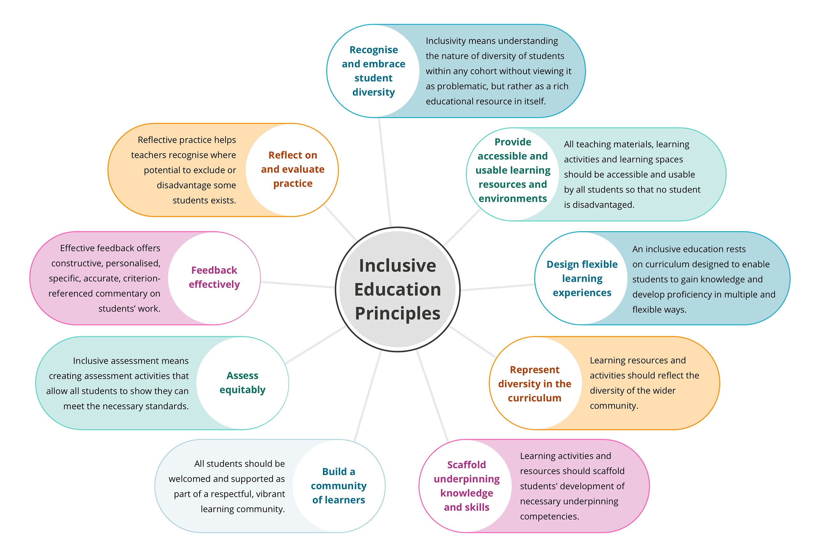
Principles of inclusive practice in HE
A quick scan of the literature reveals a multitude of principles of inclusive practice.
In the context of Higher Education, we could say that this means that students have equal access, equal opportunities, and are treated fairly to achieve success.
(Trede, Lewis & Percy, 2022)
Deakin University: Inclusive Education

Slide 6
Examples
‘Equality initiatives that only explore a single dimension of inequality (i.e. ‘just’ gender or ‘just’ race) do benefit some, but often end up leaving members of the most marginalised groups behind. We see this in curriculum design, for example, where efforts to include more women and members of racial minorities often end up introducing Black, Asian, and minority ethnic (BAME) men and white women into reading lists but ignoring BAME women entirely.’
(Dr Fran Amery, Senior Lecturer in the Department of Politics, Languages & International Studies – Intersectionality: Moving beyond a single dimension of inequality (2019))
‘…questions like race and racism, how it affects students, how it affects society…
For example, if you take the idea that students who have experienced racism might be less willing to put up their hand or venture forward ideas, because they've experienced negative reactions from teachers in the past or people in the past. They might engage with teaching formats that give students a more equal voice in the classroom.
Now, they're not evenly taken up. And I would definitely not say that we've cracked the issue of how to deal with racism in the classroom, and that we've fixed all our problems. But we're certainly a lot more literate about them than we were, previously.’
(Meera Sabaratnam, Senior Lecturer in International Relations at SOAS, University of London, UK and Chair of the Decolonising SOAS Working Group – The Internationalist, Episode 2: How can the curriculum be authentic to where it’s taught? (2020))

Slide 7
Thinking of your nomination
What is the theme / premise that runs through and unites the argument of the application?
Focus on excellence:
Your educational practice
Evidence from the literature approach/es (best practice)
Evidence of outcomes / impact
Why is this approach excellent for your context?
What are the intentional actions you are taking?

Slide 8
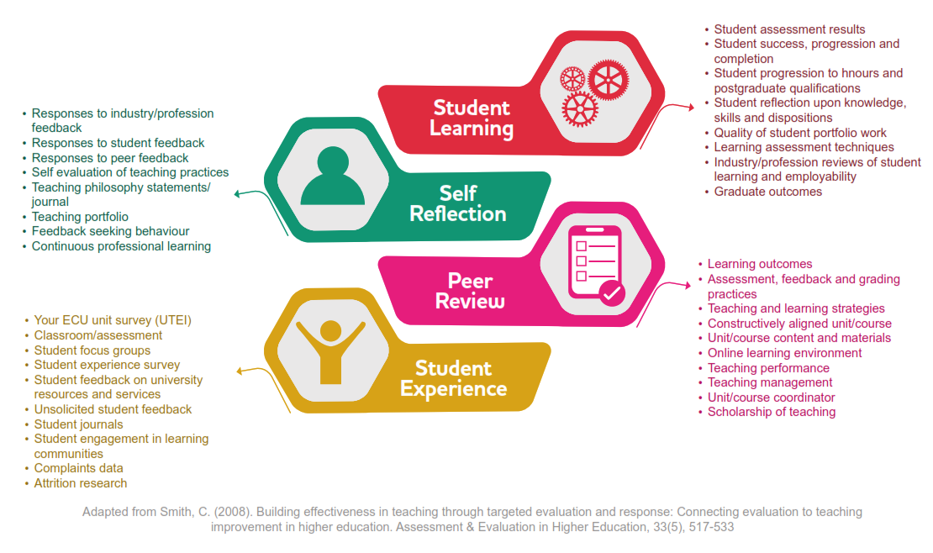
Evidence
Robust evidence base
Back up your claims
Holistic approach
variety of evidences to build a body of support
Use the 4 quadrants
If looking at particular equity groups, where possible, include comparative data

Slide 9
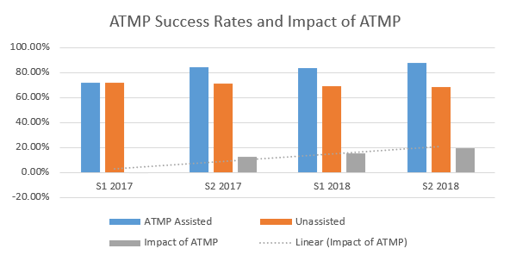
Evidence continued
Impact
Are students asked or provide comment on:
How inclusive was the curriculum, or how diverse was it?
Did the teaching methods help you feel included?
Other questions relevant to your practice…
How has staff practice changed?
Helped me learn more about what I can do to support gender equity / students with disability….
This workshop/resource/collaboration will influence they way I work in the future
Attendance at this event influenced / extended my knowledge / understanding of sexism / racism / ableism…

Slide 10
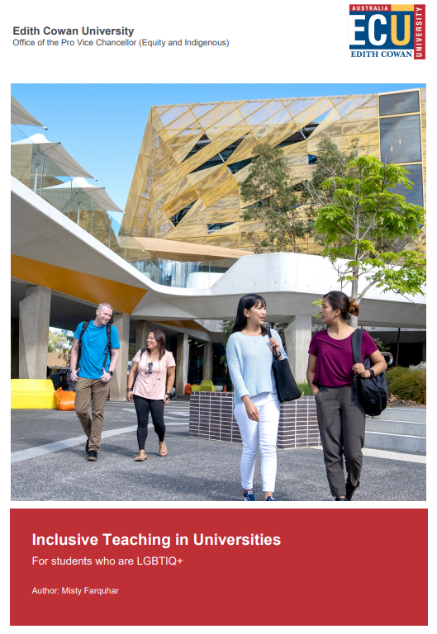
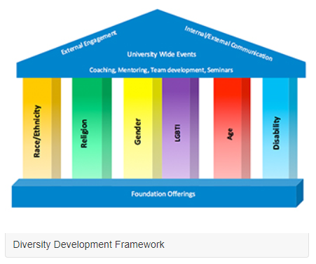
Learning more…
Resources
ECU Graduate Certificate of Academic Practice
(or micro credentials)
Communities of practice
Inclusive Education
Blended Learning
Work Integrated Learning
Scholarship of Teaching and Learning

Slide 11
Readings
National Centre for Student Equity in Higher Education (NCSEHE)
Features a research database – filter results type/focus by 3 areas: Policy, Practice, and Research
Harvey, A., Burnheim, C. & Brett, M. (Eds.). (2016). Student equity in Australian higher education: Twenty five years of A Fair Chance for All. Singapore: Springer.
Williams, D.A., Berger, J.B. & McClendon, S.A. (2005). Toward a Model of Inclusive Excellence and Change in Postsecondary Institutions. Washington: Association for American Colleges & Universities.
Zacharias, N. & Brett, M. (2019). The Best Chance for All: Student Equity 2030 — A long-term strategic vision for student equity in higher education. Final Report, National Centre for Student Equity in Higher Education (NCSEHE).
Nelson, K., Creagh, T., & Clarke, J. (2009). Social justice and equity in the Higher Education context. Literature analysis and synthesis: Development of a set of social justice principles. OLT. http://www.safeguardingstudentlearning.net/wp-content/uploads/2012/05/OLT_MSLE_Project-Literature-AnalysisFINAL.pdf
Tai, Ajjawi, Bearman, Dargusch, Dracup, Harris & Mahoney. (2022). Re-imagining exams: How do assessment adjustments impact on inclusion? https://www.ncsehe.edu.au/publications/exams-assessment-adjustments-inclusion/

Slide 12
Readings continued
LGBTIQA+
Allen, L. (2015). Queer pedagogy and the limits of thought: teaching sexualities at university. Higher Education Research & Development, 34 (4), 763-775.
Greathouse, M., BrckaLorenz, A., Hoban, M., Huesman, R., Rankin, S., & Stolzenberg, E. (2018). “Queer-Spectrum and Trans-Spectrum Student Experiences in American Higher Education.” Rutgers Tyler Clementi Center. https://tcc-j2made.s3.amazonaws.com/uploads/2018/09/White-Paper-Final.pdf.
Ward, N., & Gale, N. (2016). LGBTQ-inclusivity in the Higher Education Curriculum: a best practice guide. Retrieved March 2022 from: https://intranet.birmingham.ac.uk/staff/teaching-academy/documents/public/lgbt-best-practice-guide.pdf.
Disability
Koshy, P. (2020). Equity Student Participation in Australian Higher Education: 2014 – 2019. National Centre for Student Equity in Higher Education (NCSEHE), Perth: Curtin University.
Koshy, P. (2016). Equity Policy in Australian Higher Education: Past, present and prospective. in Hill, M., Hudson, A., Mckendry, S., Raven, N., Saunders, D., Storan, J. & Ward, T. (eds.), Closing the Gap: Bridges for Access and Lifelong Learning, London: Forum for Access and Continuing Education. pp. 277-302.

