Slide 1
Implementation of OneNote Class Notebook in Chemistry Laboratory Classes @ ECU “The Good, The Bad and The Future”
Magdalena Wajrak
Chemistry Lecturer
School of Science
(m.wajrak@ecu.edu.au)

Slide 2
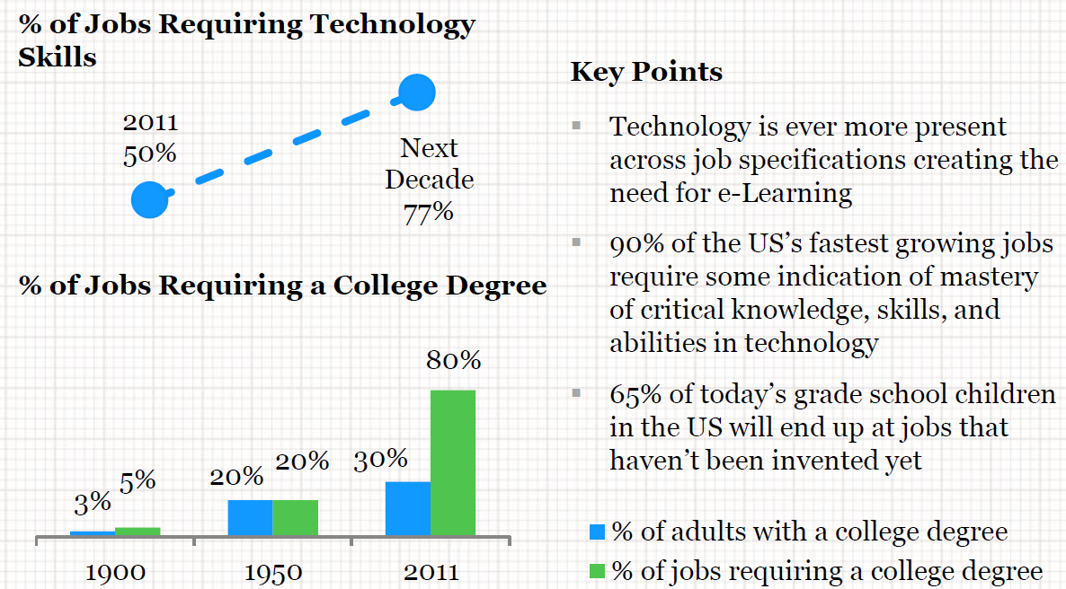
Rationale – The Good
Electronic lab books are used in research laboratories
With the ‘innovative use of digital learning technologies in curriculum delivery and assessment’ and an estimated 77% of jobs requiring technological skills by 2020 (IBIS Global eLearning Investment Review), it is crucial that our students are exposed to the latest technology not only in the actual unit content, but also in the way the content is being delivered.
Push from the Dean of T&L, School of Science for ‘digitization’ of chemistry teaching.

Slide 3
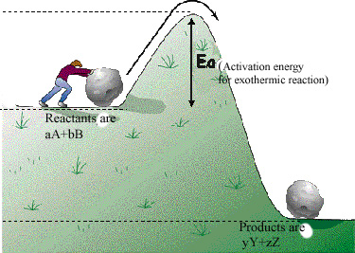
First Trial Issue and Obstacles) – The Bad
Trial implementation of electronic lab books in first year advance chemistry unit was done in Semester 2, 2018 using OneNote Class Notebook (desktop 2016 version).
Finding appropriate tablets for each student – applied for T&L grant, didn’t get it, instead received unwanted Asus Transformer tablets.
IT were scratching their heads

Slide 4
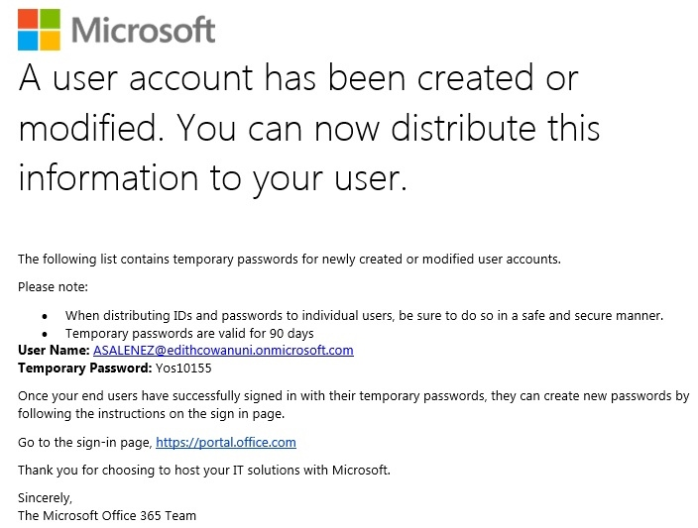
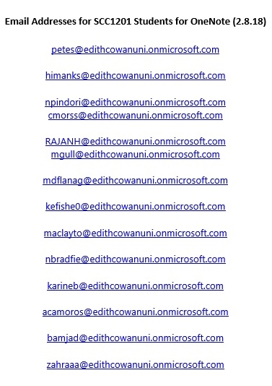
First Trial (Issues and Obstacles) – The Bad
Tablets were not standard
Did not have OneNote/Excel installed
Licence issues to install OneNote 2016 desktop and Excel
Had to log in using a local account
Students were in a separate tenancy
Had to create a separate log-in in new tenancy (had to manually add student email addresses – lucky only 14 students)
Log-in for new tenancy had no wi-fi access
Students had to connect to wif-fi with their student account

Slide 5
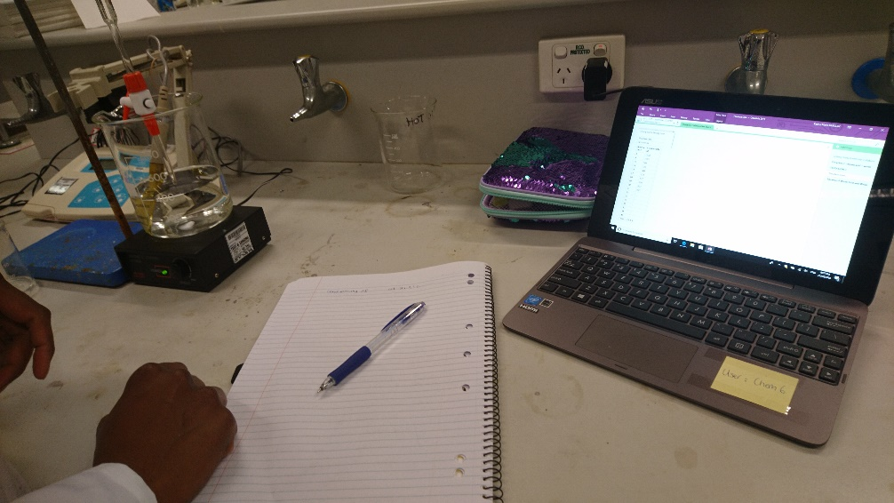
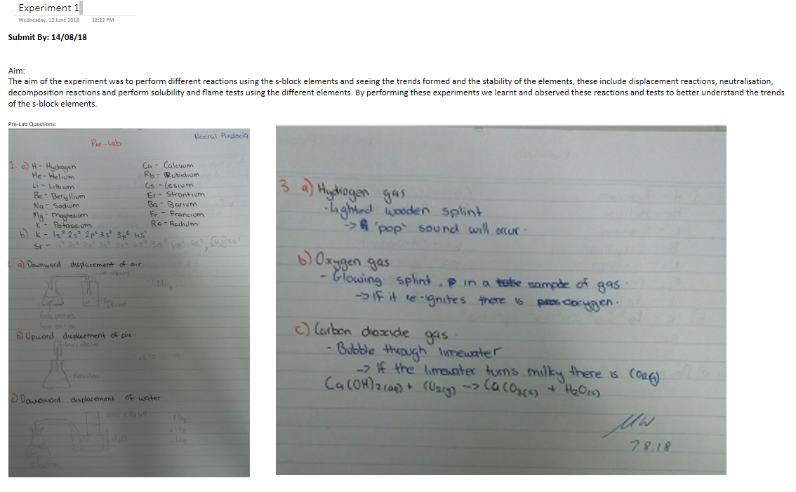
First Trial (Issues and Obstacles) – The Bad
Asus tablets were old, slow, small and had a battery charging problem
Kept plugged in
No styluses = very poor digital ink experience
IT provide styluses
Limited formatting options in OneNote
Suggested tables
No training or previous experience with OneNote
Students found workarounds
Provided instructions as needed

Slide 6
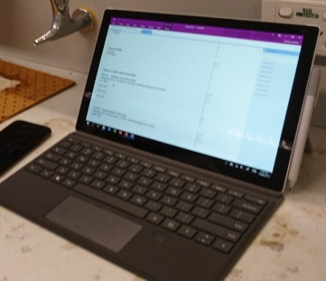
Second Trial (Improvements) – The Good
First trial generated significant interest from ITSC and Dean of T&L – new science building being built and planning of a fit out of new superlabs (good timing). Second trial strongly supported for Sem 2, 2019:
SCC1123 (foundation of chemistry unit, 55 students) and SCC1201 (advanced chemistry unit, 23 students)
Each student assigned particular Surface Pro and stylus pen
26 Surface Pros on loan from Microsoft
Assistance from ECU Business Systems Centre

Slide 7
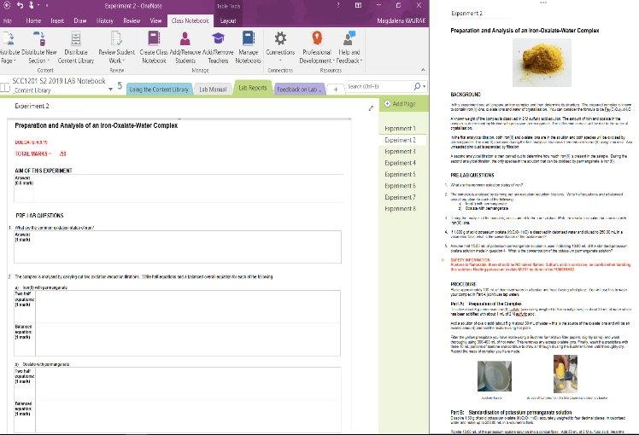
Second Trial (Improvements) - The Good
Structured lab report templates (easier for students to complete and focus is on the chemical content not formatting of their lab reports)
Lab manuals more interactive (instructions provided not just in text format, but also in diagrams, photos and videos)

Slide 8
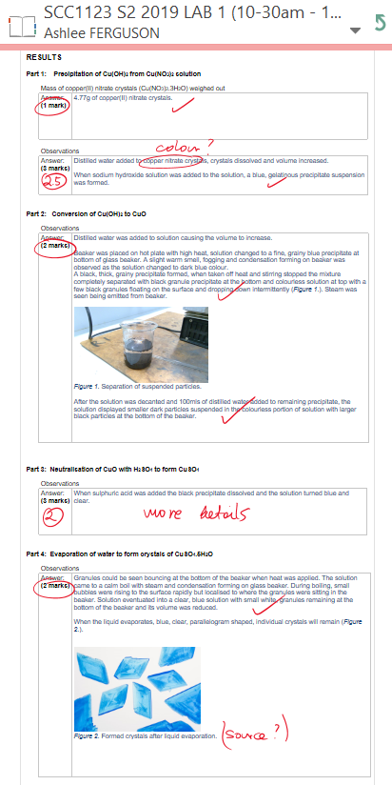
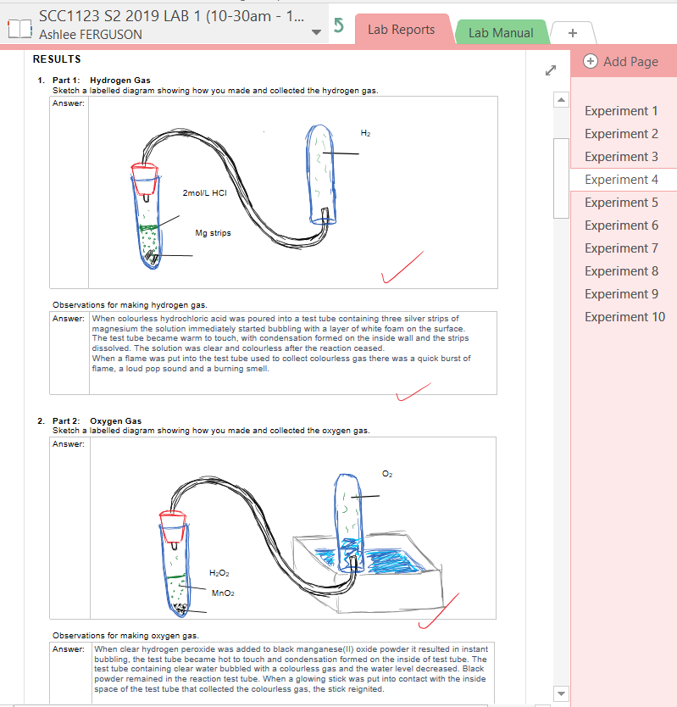
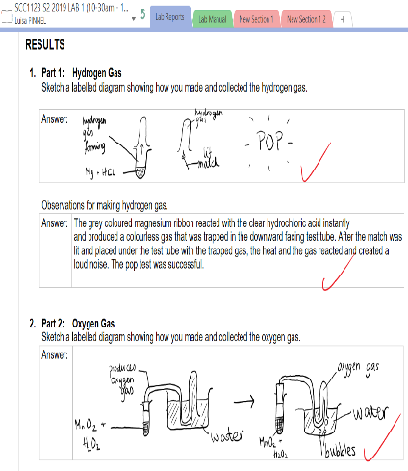
Second Trial (Improvements) - The Good
Reports contain sketched diagrams of experimental set-up, photos and videos of chemical reactions.
Stylus pen is fantastic for drawings and sketches.
Improved engagement during laboratory classes!

Slide 9
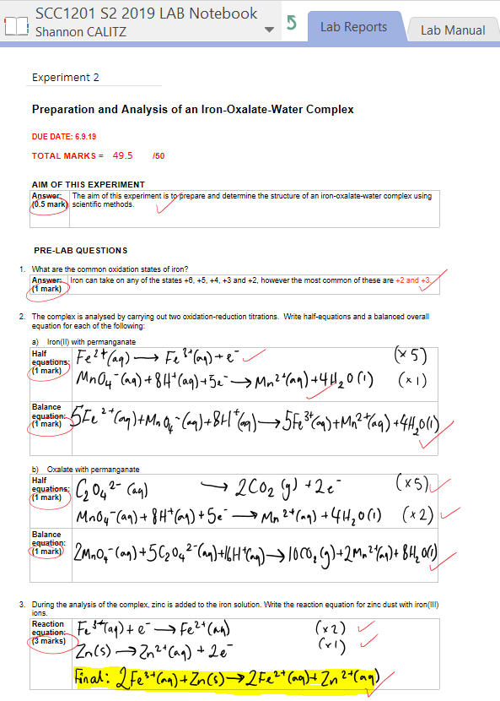
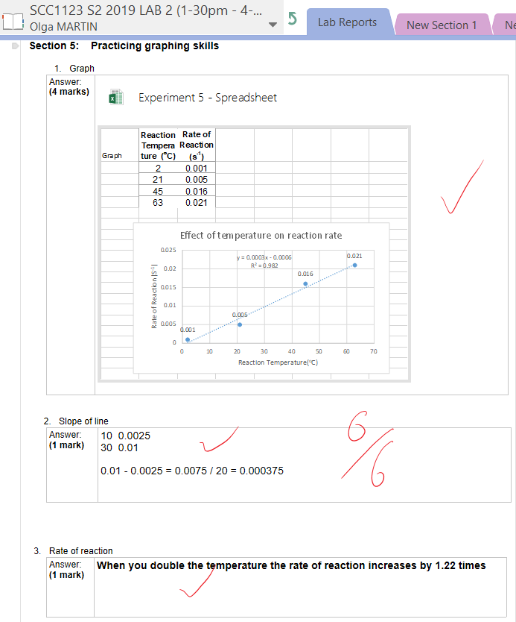
Second Trial (Improvements) - The Good
Stylus pen ideal for writing chemical equations.
Ability to perform data analysis in the lab as data is collected using Excel program.
Improved engagement during laboratory classes!

Slide 10
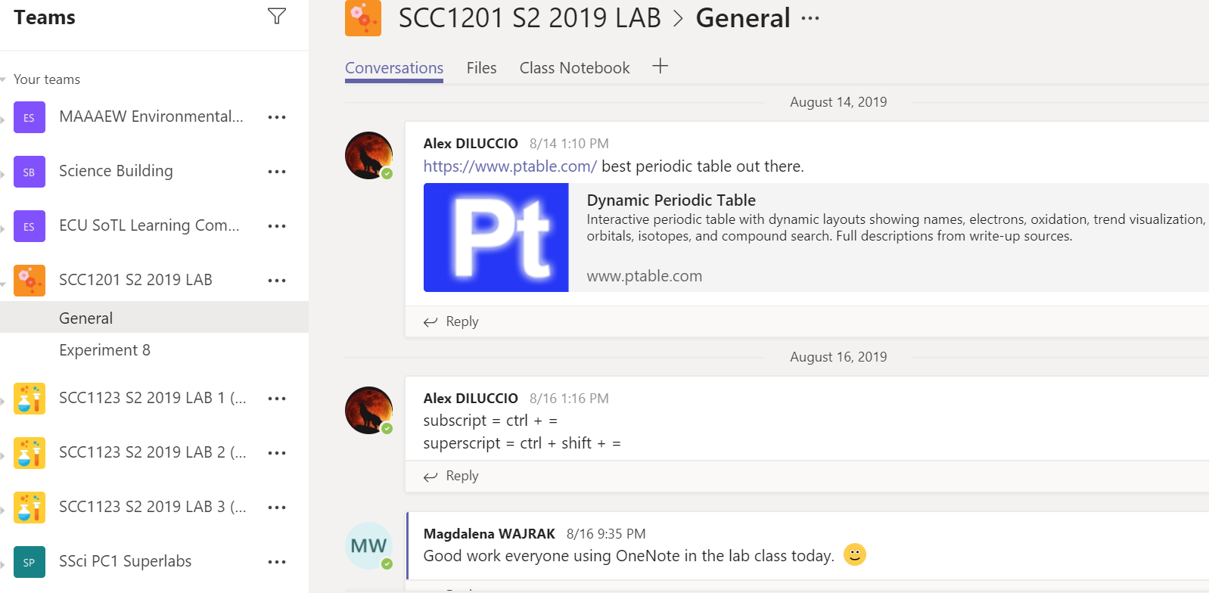
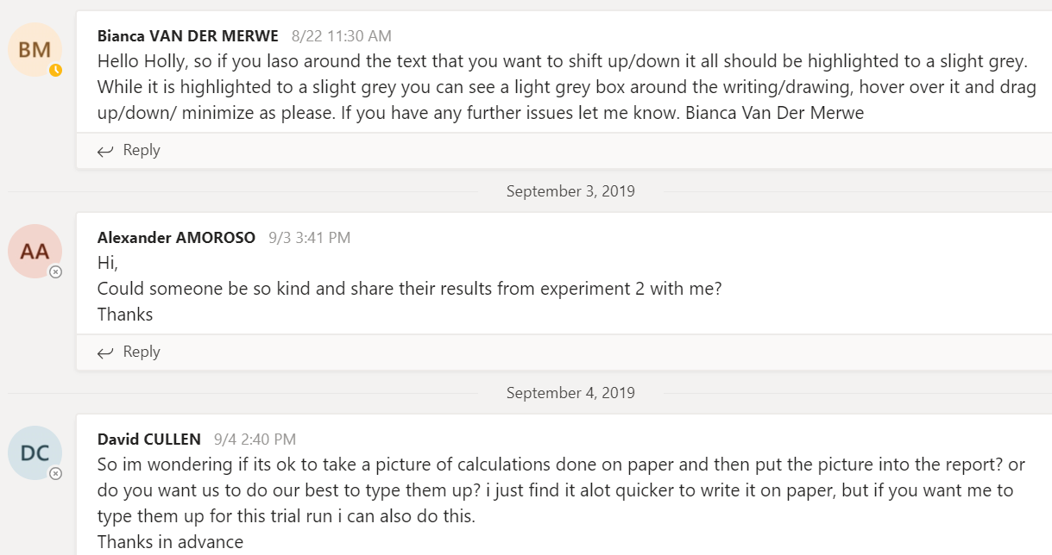
Second Trial (Improvements) - The Good
Utilise Teams for increased collaboration and engagement in lab classes.

Slide 11
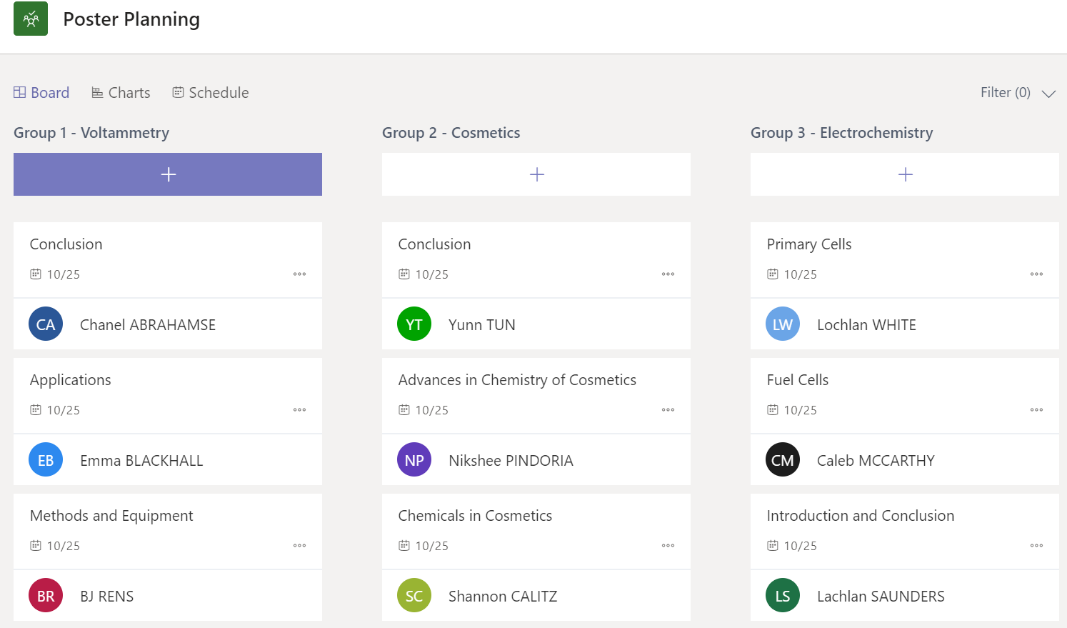
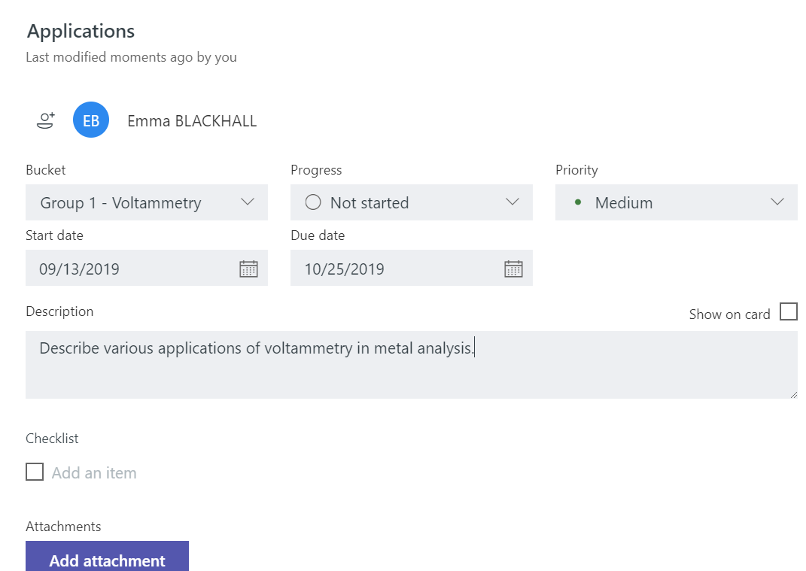
Second Trial (Improvements) – The Good
Utilise Teams for better collaboration, reporting and task allocation in group work.

Slide 12
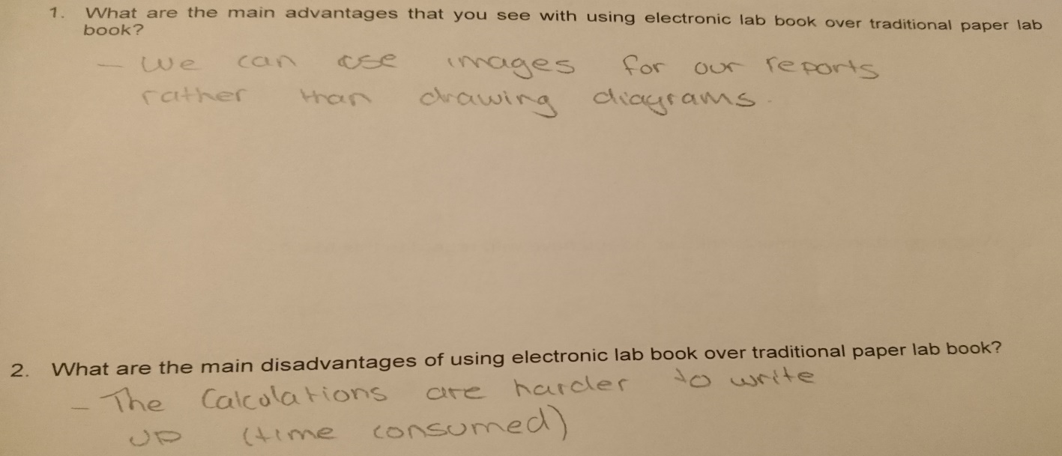
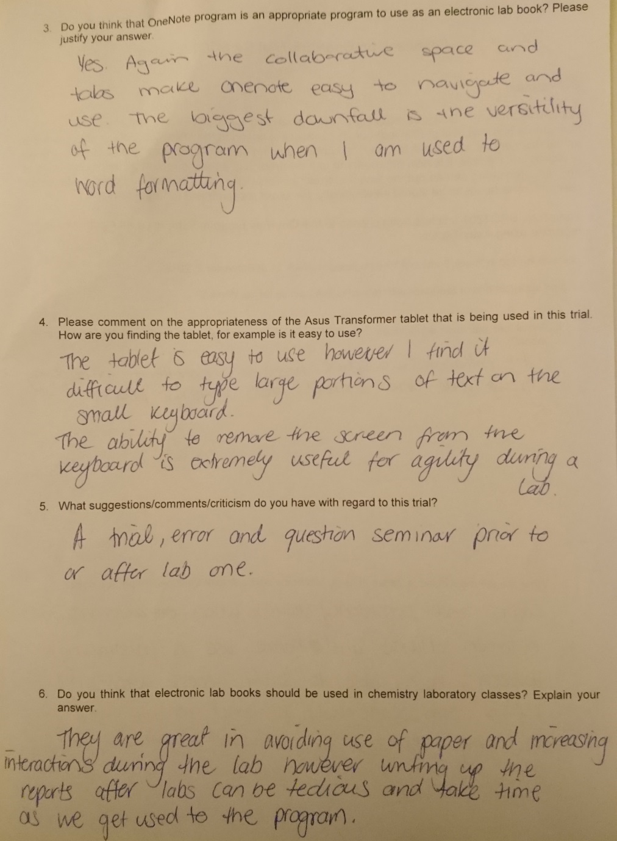
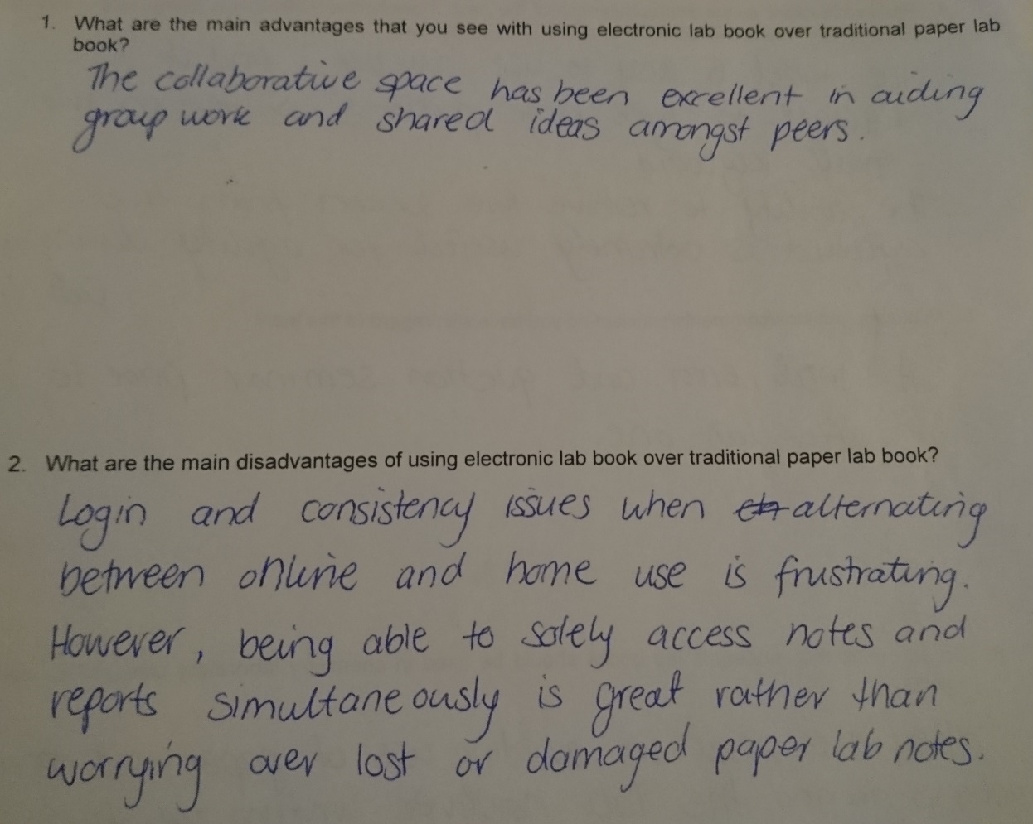
Feedback from Semester 2, 2018 - Not so Good

Slide 13
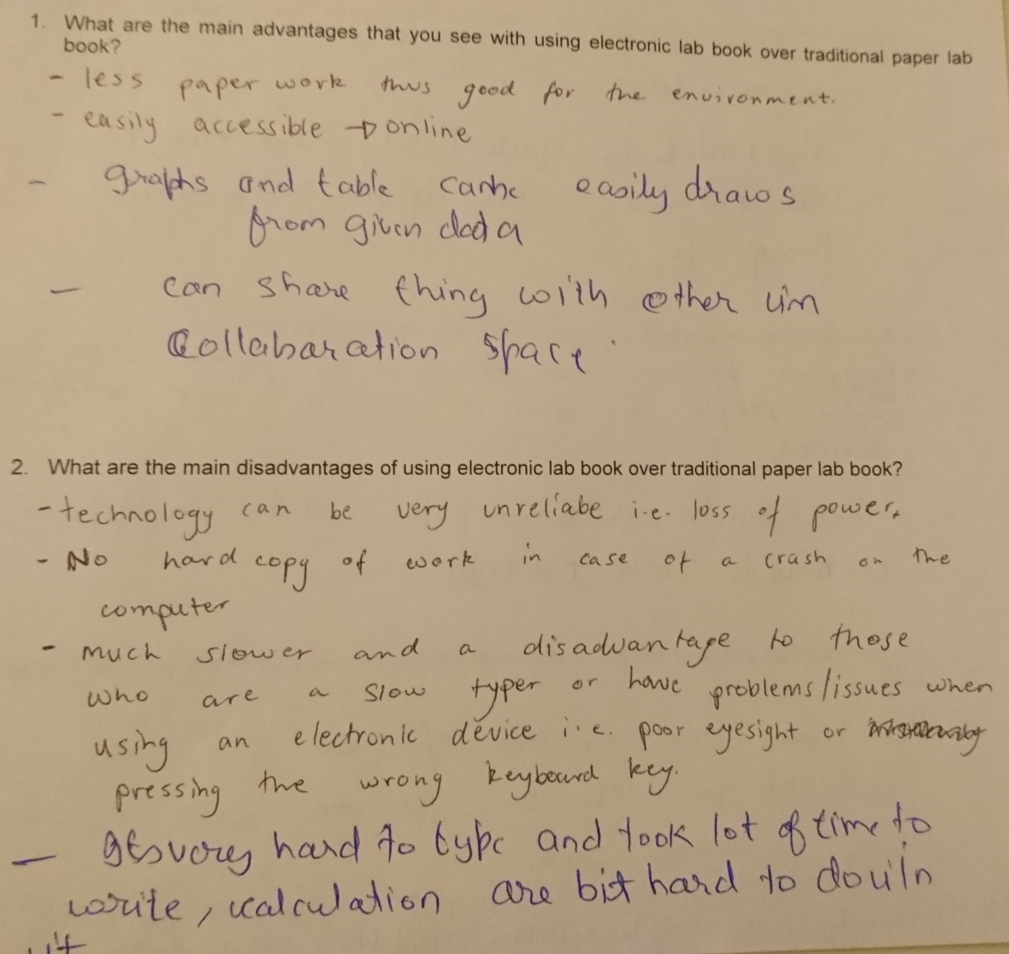
Feedback from Semester 2, 2018 - Not so Good

Slide 14
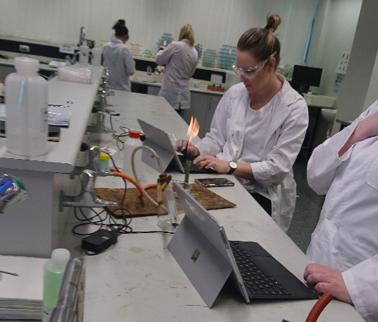
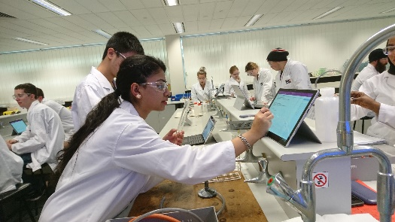
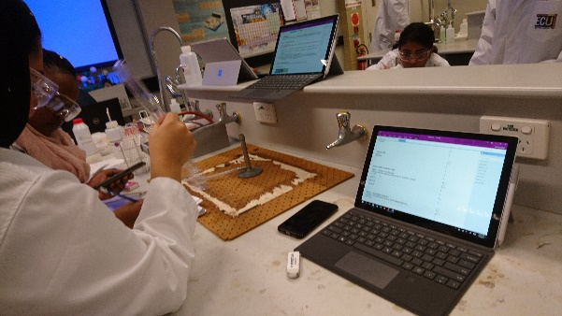
Feedback from Semester 2, 2019 - Better
Overall more positive, however, still need to address issues such as; students require more OneNote training, wifi drop-outs causing syncing problems and movement of drawings, photos and videos inserted within lab reports.

Slide 15
The Good, The Bad and the Future
The Good:
saving paper and printing costs
learning new computer skills
more information recorded about each experiment
lab instructions can be changed on the go
no lost lab books
more likely to check on feedback
no left over lab reports piling outside my office
students get feedback immediately in the lab
focus is on concepts and theory
The Bad:
students still require more OneNote training
wifi drop-outs causing syncing problems
movement of drawings, photos and videos inserted within lab reports
extra time needed in the lab class to log into OneNote
The Future:
based on this trial 96 Surface Gos are being purchased by ECU for the new science building and superlabs
third trial in Semester 1, 2020 with 350+ students

Slide 16
Additional Information
There are two versions of OneNote:
OneNote 2016 desktop version – inserting photos, videos, excel spreadsheet
OneNote Windows 10 app – none of the above
Make sure that you activate Class Notebook option within OneNote

Slide 17
Acknowledgements
Athena Swan - ECU UniSuper Development Fund
Dean of Teaching and Learning, School of Science
Sam Prosser - Senior Business Analyst
Mariet Labuschange - Manager of Business Systems
Wasim Anwar and Sheldon Jones - Microsoft

Slide 18
References
IBIS Global eLearning Investment Review, January 2013
Microsoft Teams and OneNote Summit at Griffith Uni, June, 2019.
Microsoft Teams and OneNote Summit, June, 2019 Presentation:
https://www.youtube.com/watch?v=TcxwJ8cQaWw&feature=youtu.be
Link to use of OneNote Class Notebook for teaching Physics:
https://www.youtube.com/watch?v=XBdVPJ5a6Dw

